Slide 1
Identifying Nashville’s Popular Pythonistas with NetworkX
November 16, 2017
Stephen Bailey
Notes:
Name, currently a grad student
Relatively new to PyNash – don’t know much about software engineering – pretty hacky most of the time.
One thing I do know about is networks.

Slide 2

What groups should I attend?
Who should I get to know?
Where should I advertise?
Notes:
* You're new to Nashville. You're ready to start meeting people, making friends, expanding your network. But you don't want to get pigeon-holed into just one group, i.e. the people you might already know / are comfortable with. Maybe you're trying to market yourself / a product.
* There’s a lot of people. And some are more connected than others. So if you want to get to “where you belong” quickly, you want to find the “connector people”.
Similarly, what groups should you join? Do you want to join the group of 5 people who play Dungeons and Dragons on the weekend, and have for the past five years?
Who should you talk to in those groups? Wouldn't you rather be invited into a group than just show up at one?

Slide 3
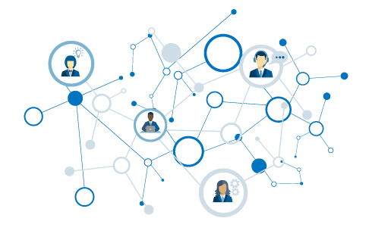
Popular Pythonistas
What is a network?
Building graphs
Who’s who in PyNash?

Slide 4
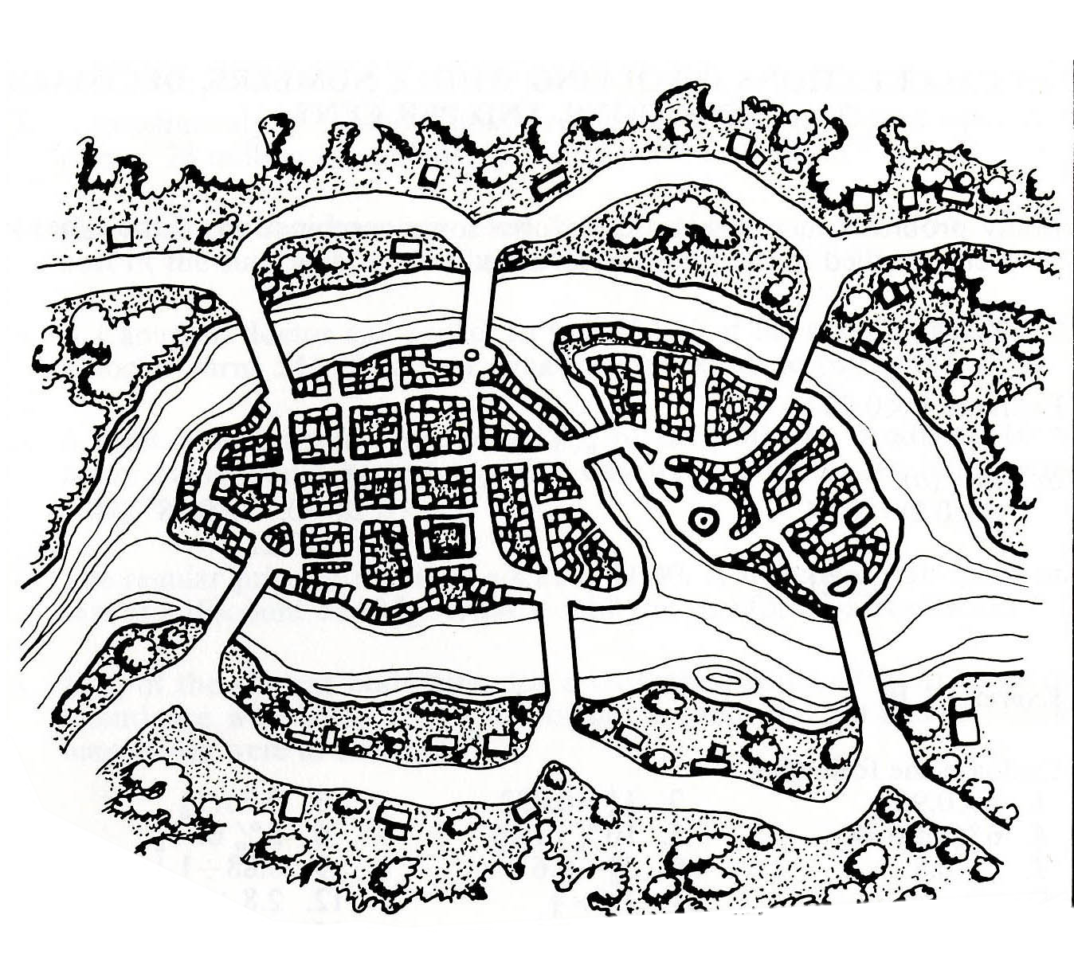
Can you traverse every bridge just once?
2
1
3
4
5
6
7

Slide 5
A
2
1
3
C
B
4
5
6
7
D

Slide 6
Graph
A
Node
B has the most connections
B
C
Edge
D
A & D are on the “outside” – they are not connected to each other
Notes:
Without knowing anything about this system, what is one thing you might say?
B seems to be the most “important” place – has the most connections.
B and C are seem to be more central to the graph – A and D are both on the edges

Slide 7
1
1
To travel into AND out of a node, requires 2 steps (or 4 or 6…).
Therefore… either:
All nodes are even.
Exactly two nodes are odd.
2
2
1
3
2
Notes:
Without knowing anything about this system, what is one thing you might say?
B seems to be the most “important” place – has the most connections.
B and C are seem to be more central to the graph – A and D are both on the edges

Slide 8
Back to Konigsberg…
3
5
3
Four nodes with odd number of edges!
3
Notes:
Without knowing anything about this system, what is one thing you might say?
B seems to be the most “important” place – has the most connections.
B and C are seem to be more central to the graph – A and D are both on the edges

Slide 9
That’s the ticket…
3
4
3
2
Notes:
Without knowing anything about this system, what is one thing you might say?
B seems to be the most “important” place – has the most connections.
B and C are seem to be more central to the graph – A and D are both on the edges

Slide 10
Graphs
Useful for understanding relationships.
Describe topology (arrangement) of networks.
Many possible measurements to derive.

Slide 11
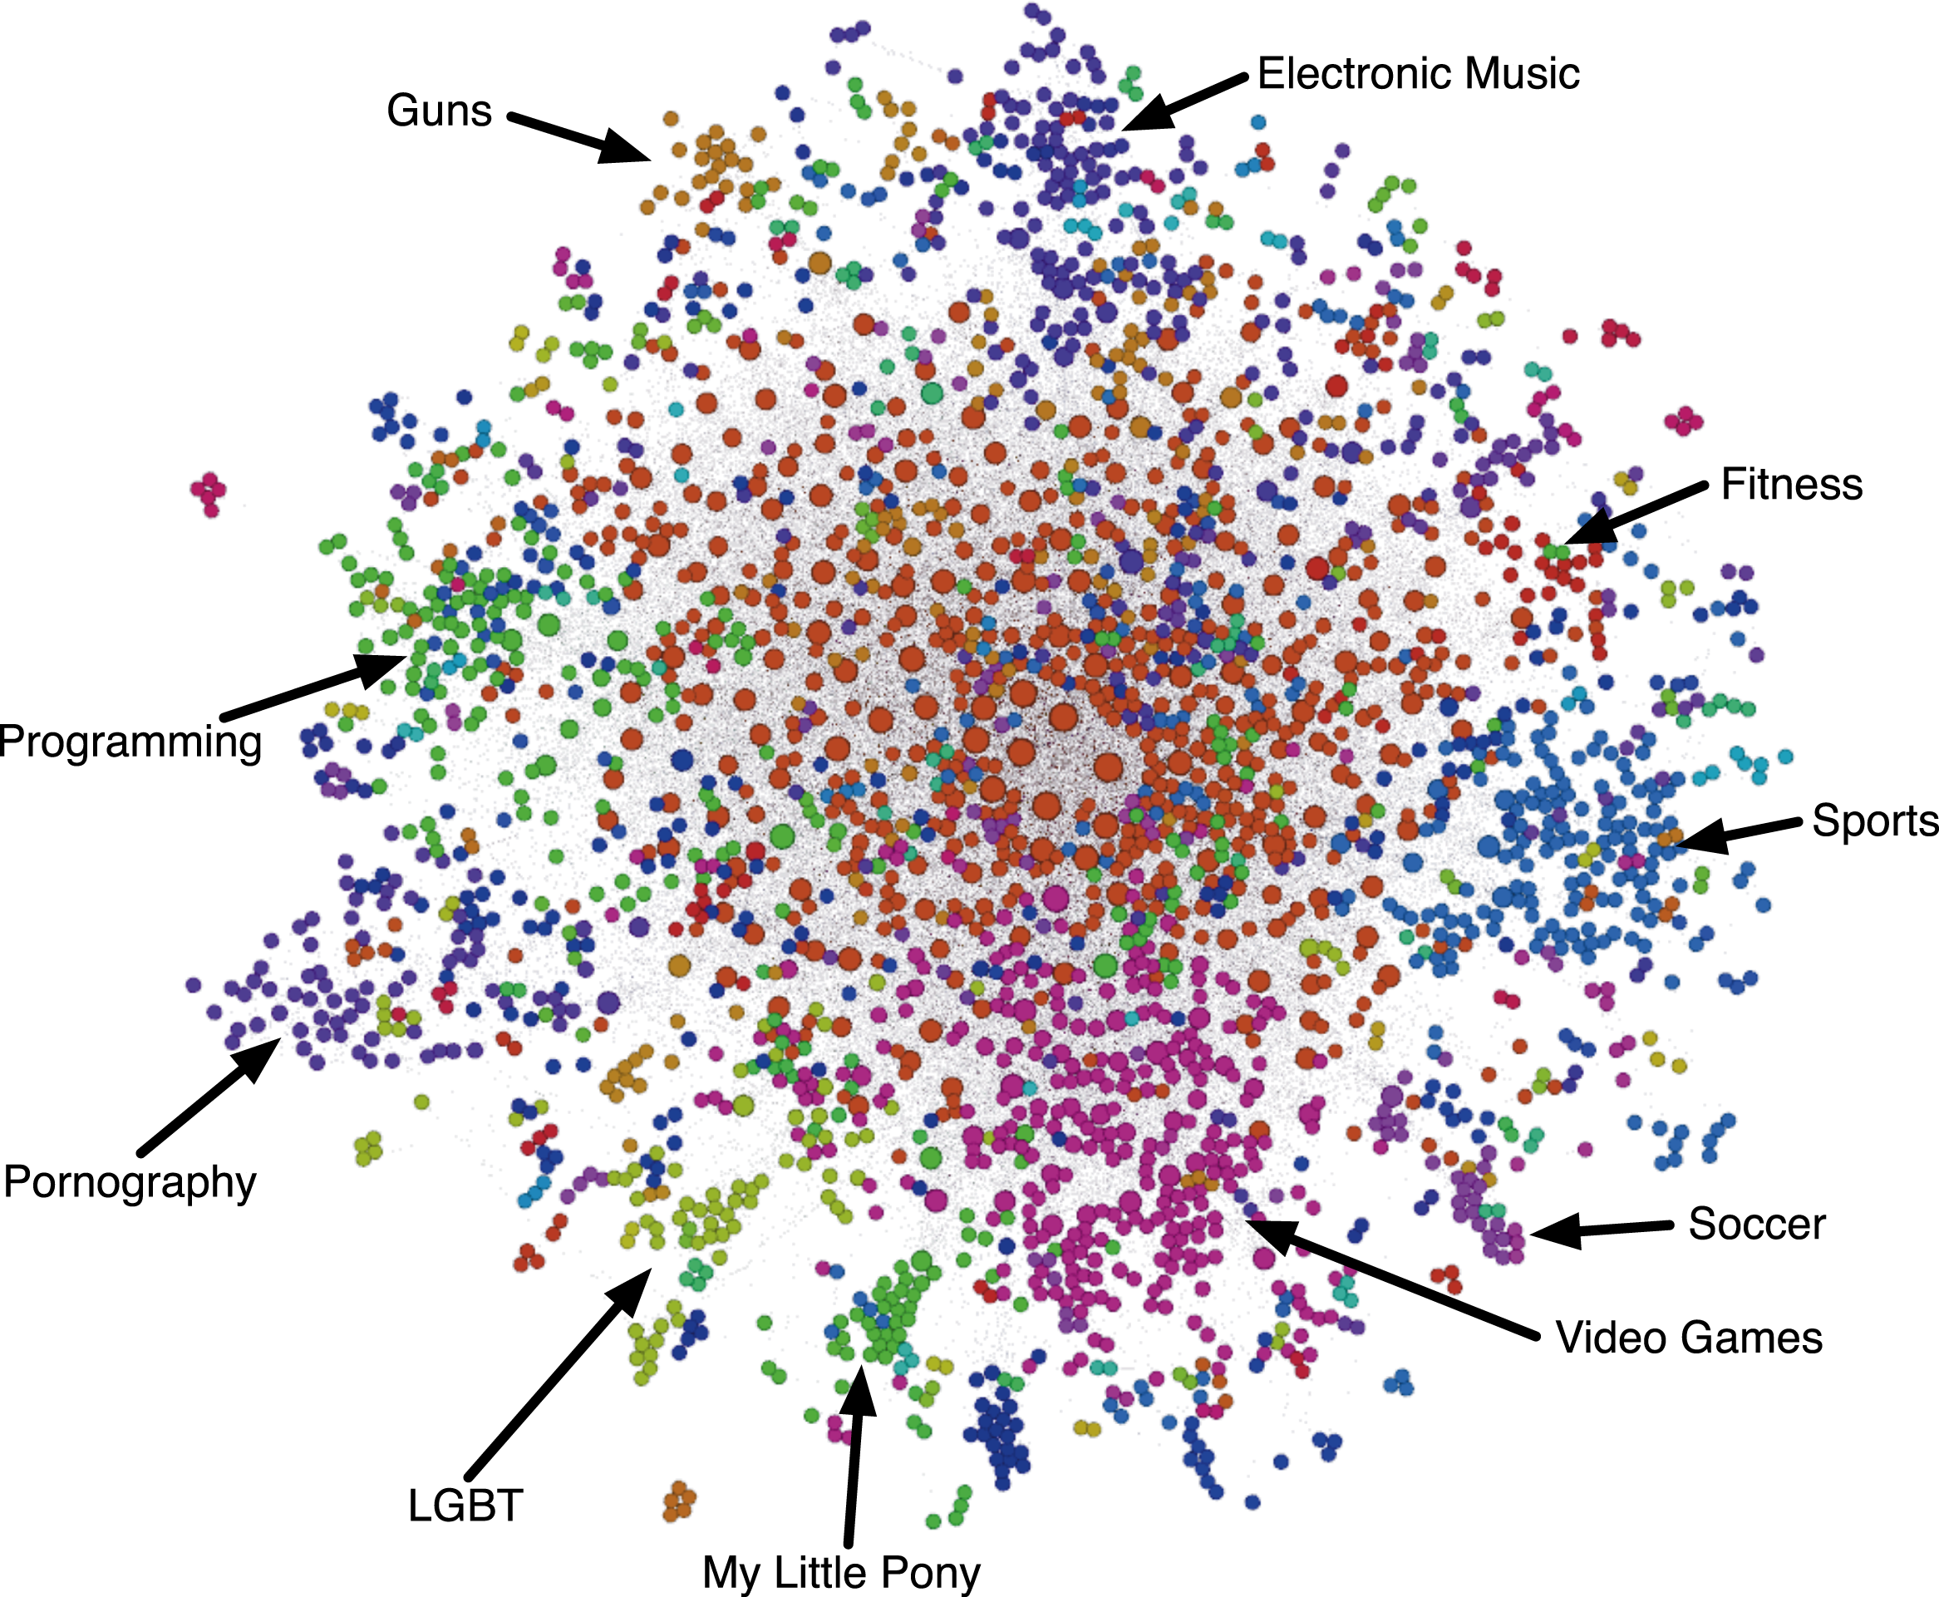
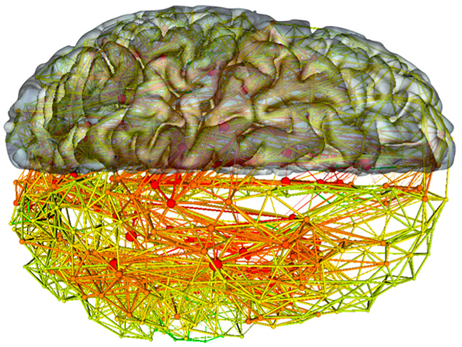
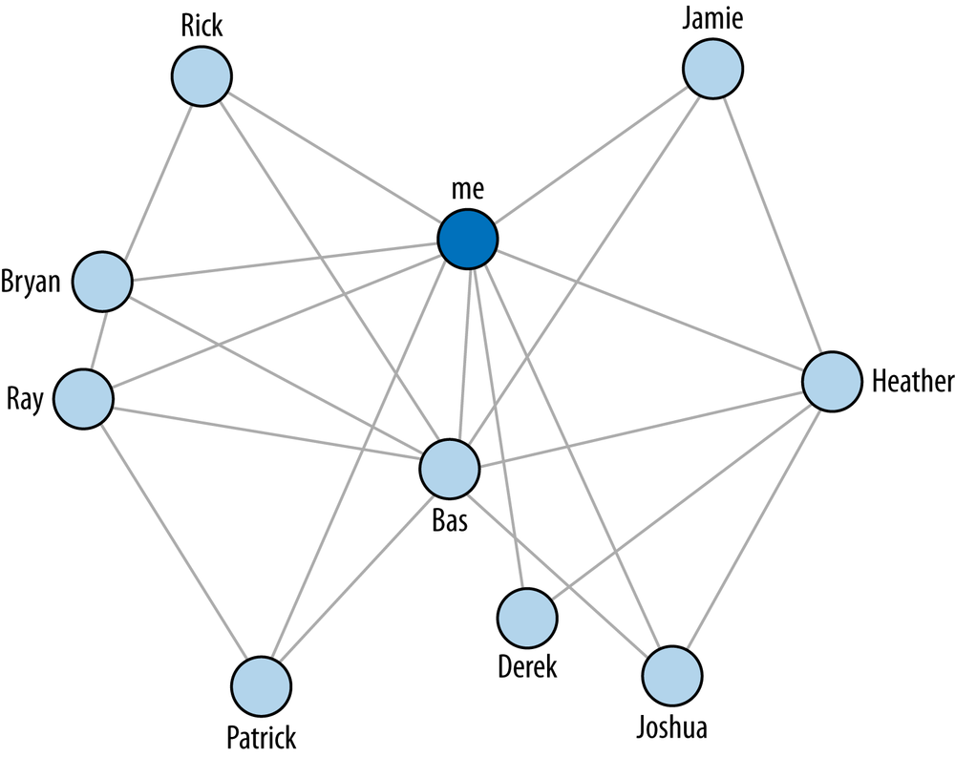
Notes:
Without knowing anything about this system, what is one thing you might say?
B seems to be the most “important” place – has the most connections.
B and C are seem to be more central to the graph – A and D are both on the edges

Slide 12
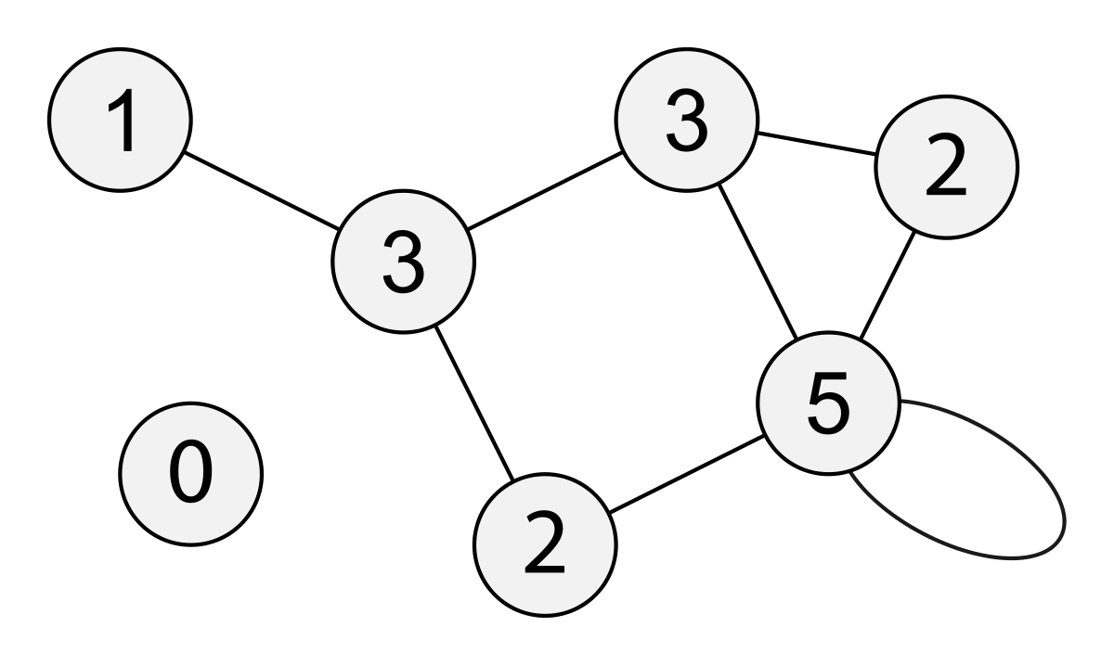
Common Measures
Degree
Notes:
Path length – average

Slide 13
Common Measures
Degree
Path Length
Notes:
Path length – average

Slide 14
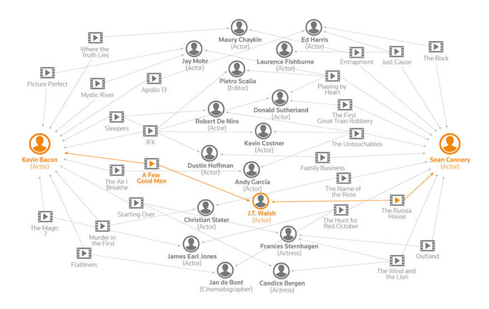

Slide 15
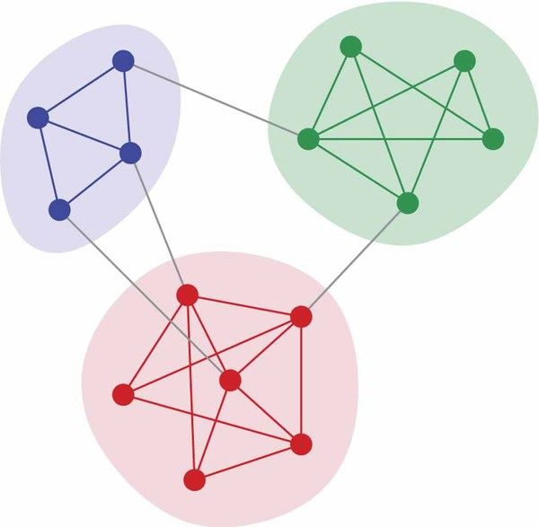
Common Measures
Degree
Path Length
Clustering
Notes:
Path length – average

Slide 16
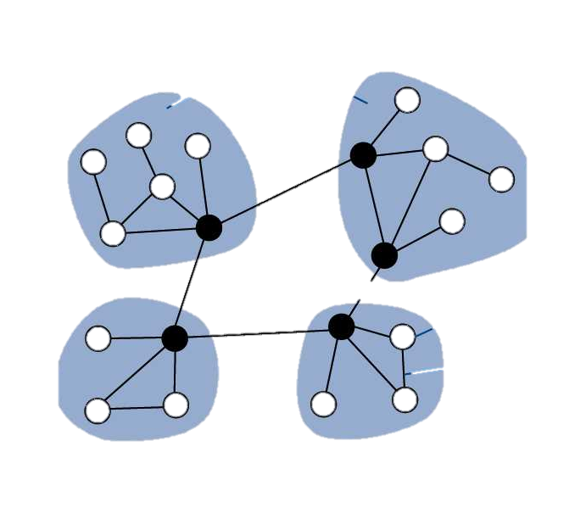
Common Measures
Degree
Path Length
Clustering
Centrality
Notes:
Path length – average

Slide 17
Adjacency Matrix
A
B
C
 | A | B | C | D
A | - | 2 | 1 | 0
B | 2 | - | 1 | 2
C | 1 | 1 | - | 1
D | 0 | 2 | 1 | -
D

Slide 18
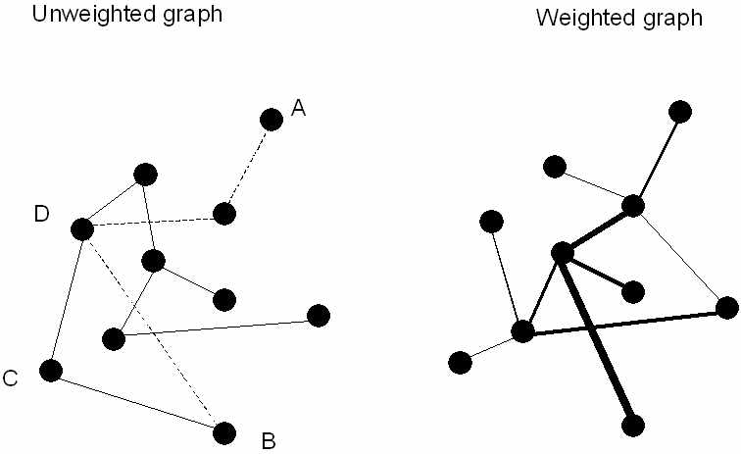
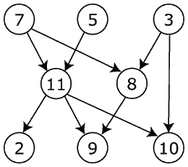
Multiple graph types
UNDIRECTED
DIRECTED

Slide 19
Popular Pythonistas
What is a network?
Building graphs
Who’s who in PyNash?

Slide 20
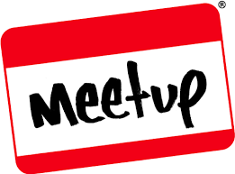
The MeetUp Data
Used MeetUp API to get the following information:
All groups within 25 miles of Nashville.
All members of those groups.
All events for each group and who RSVPed yes.
(Everything is on Github)

Slide 21
PyNash Relationships
We have >1400 members. But not all of them come to every meeting. (And many don’t come to any meetings.)
So we want to build a graph where…
each node is EITHER a person or event
Each edge represents attendance at that event

Slide 22
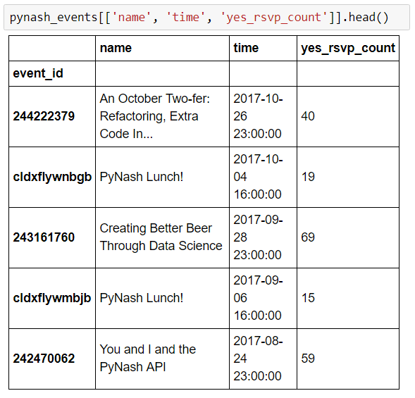
Building a graph: The data

Slide 23
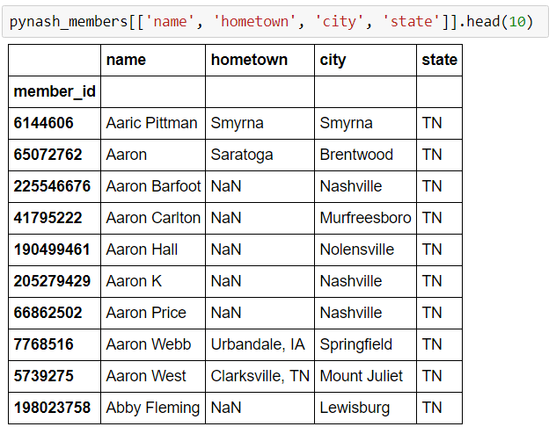
Building a graph: The data

Slide 24
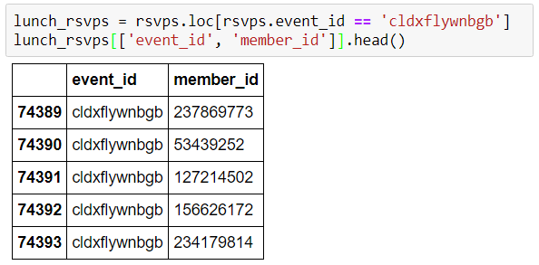
Building a graph: The data

Slide 25
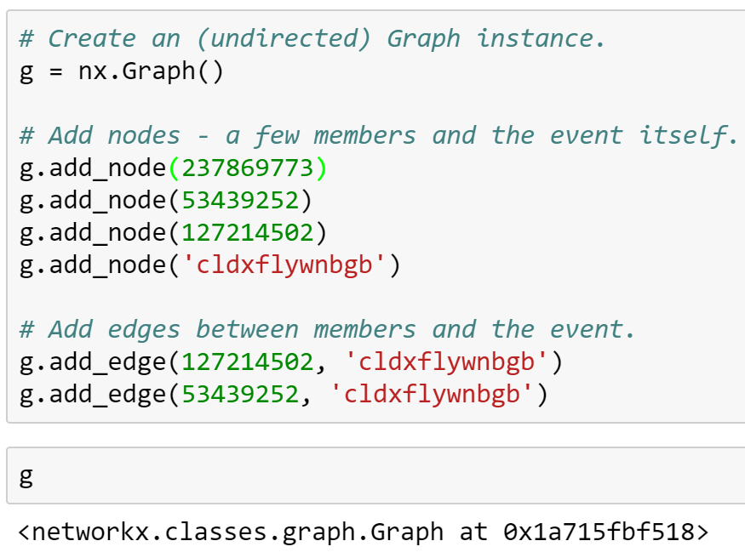
Building a graph: Declarative Syntax

Slide 26
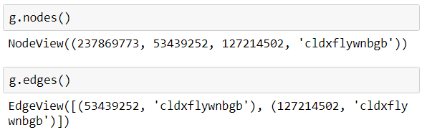
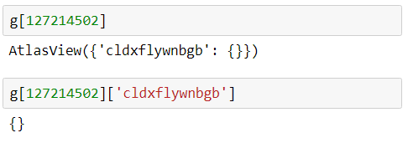
Slicing the graph
Graphs are setup as dicts-of-dicts-of-dicts.
Source: Target: Attrs

Slide 27
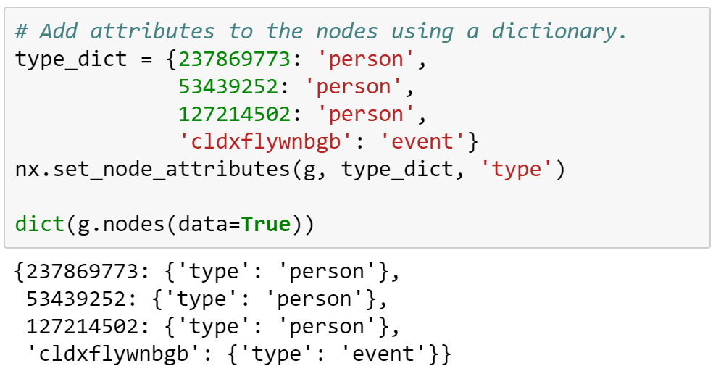
Adding attributes

Slide 28
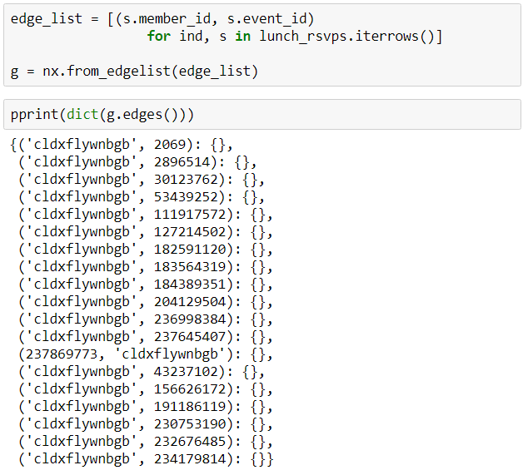
Building a graph: From an edge list

Slide 29
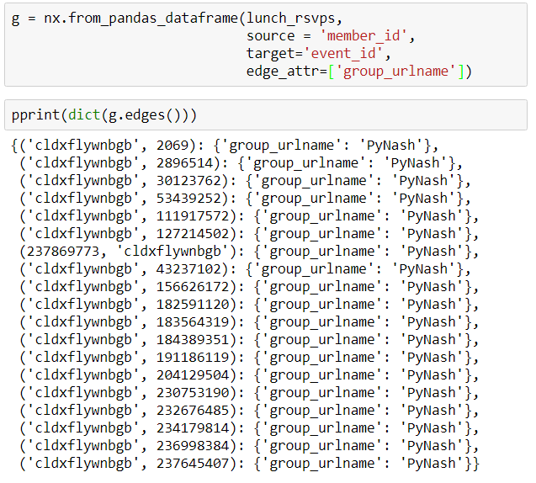
Building a Graph: From Pandas DF

Slide 30
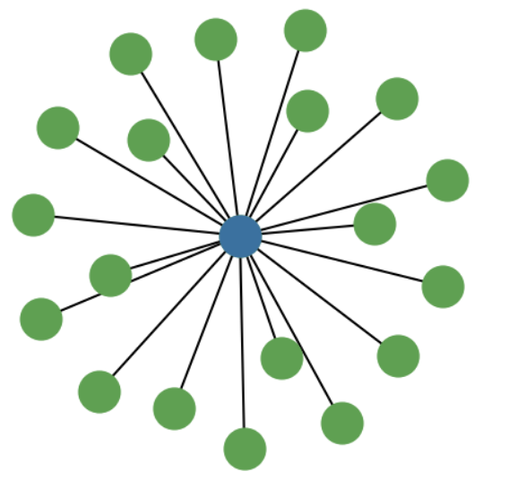
The lunch graph
Degree of the event = 19 (RSVPs)
Degree of the members = 1 (event attended)

Slide 31
Project Bipartitate Graphs (Person, Event) to (Person, Person)
We want to take

Slide 32
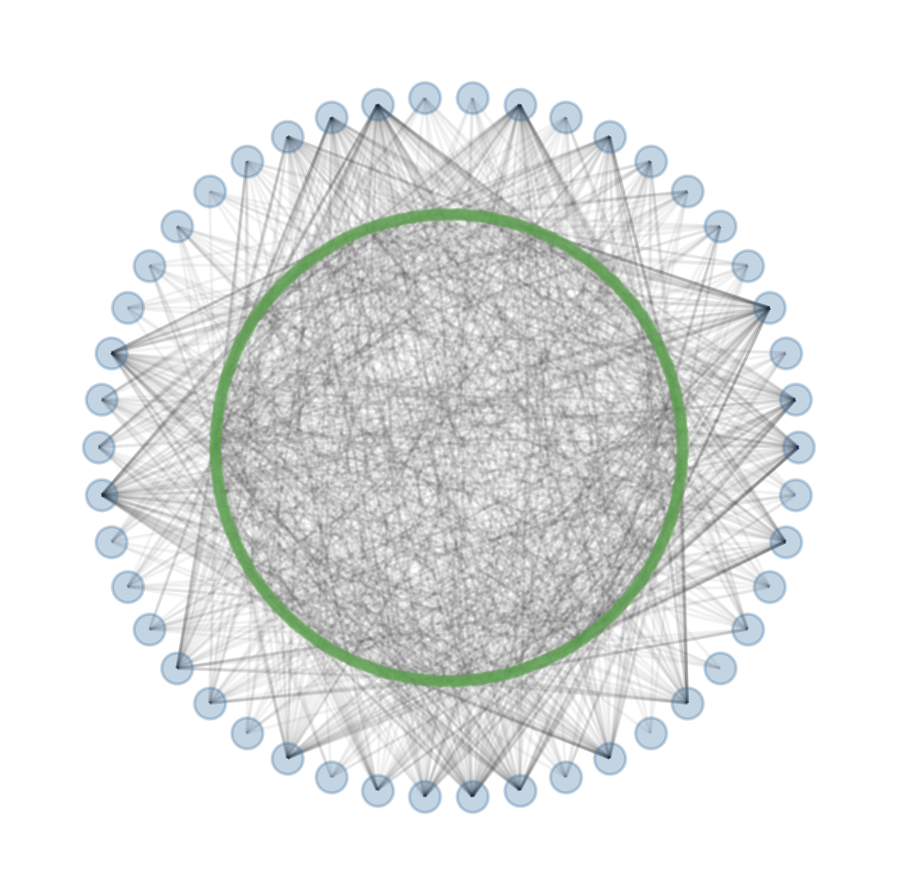
Current Graph Structure

Slide 33
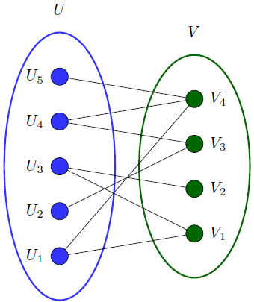
Bipartite Graphs
Great initial starting place for some datasets.
Can take the form of (Person node → Affiliation node)
e.g. (Sports fan → Sports team)

Slide 34
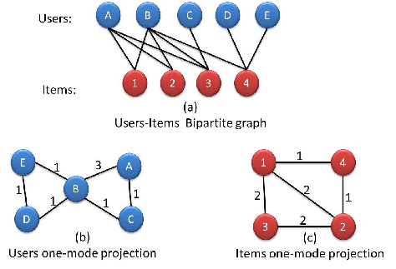

Slide 35
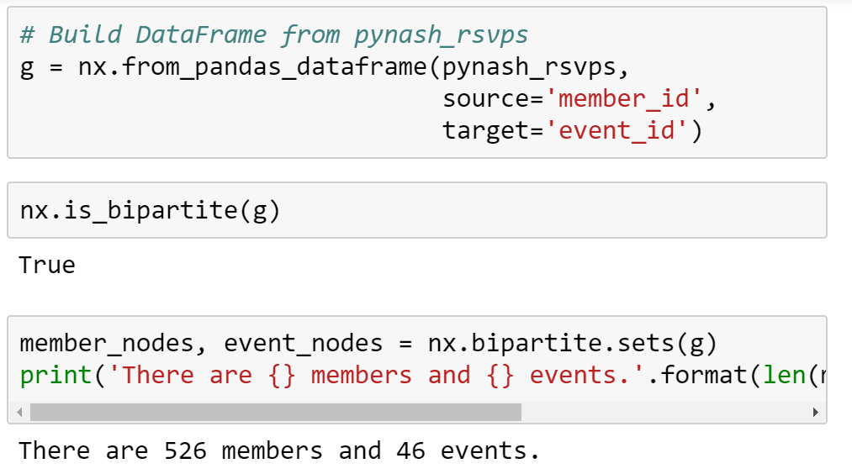
Reformatting the PyNash Graph

Slide 36
Building the PyNash Graph

Slide 37
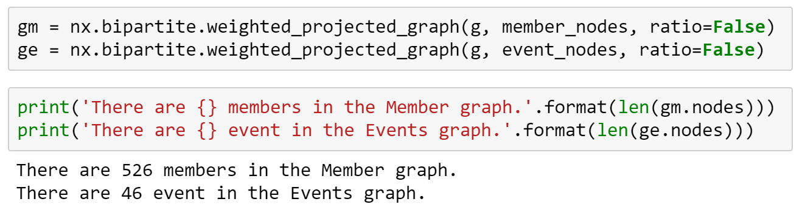
Projecting the graph

Slide 38
The final product
Now we have a graph with the following attributes:
Node: a person who attended at least one event in the past two years
Edge: shared event between two people
Edge weight: the number of shared events

Slide 39
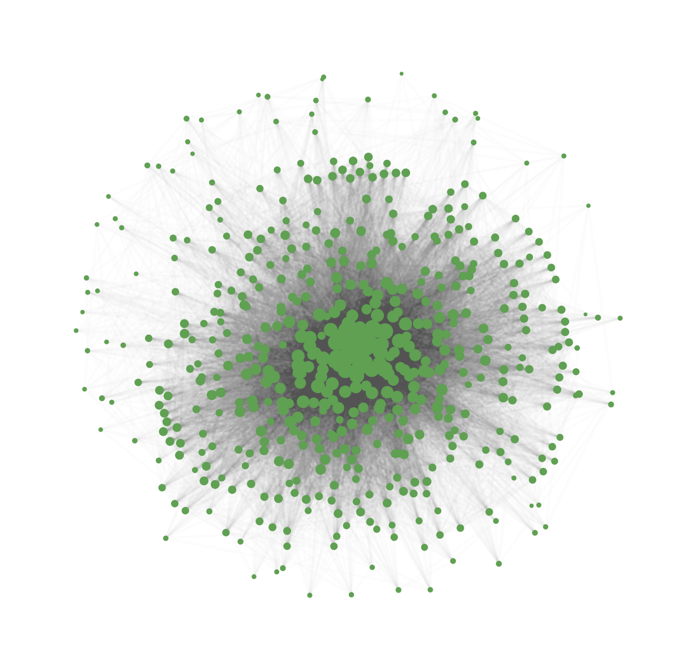
Member Structure

Slide 40
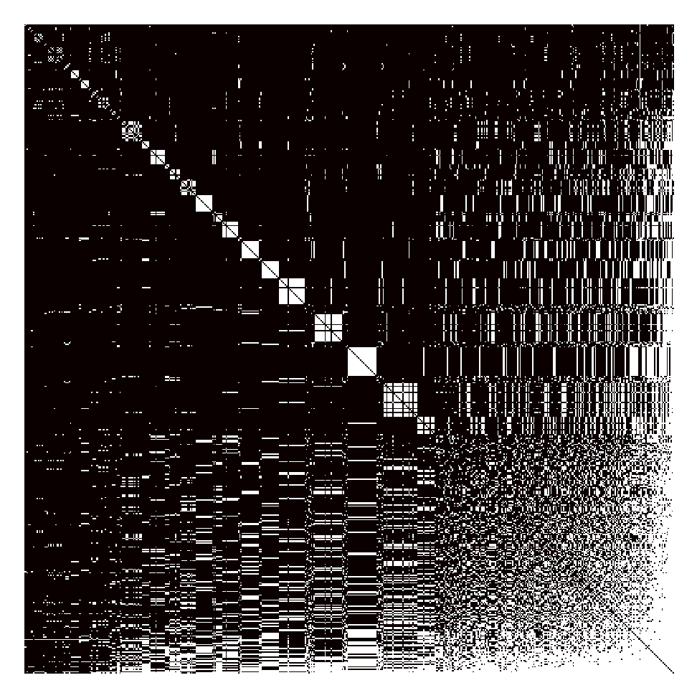
Adjacency Matrix
Matrix representation of graph edges
N*N binary array

Slide 41
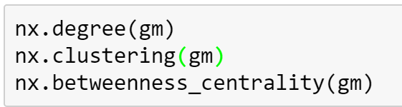
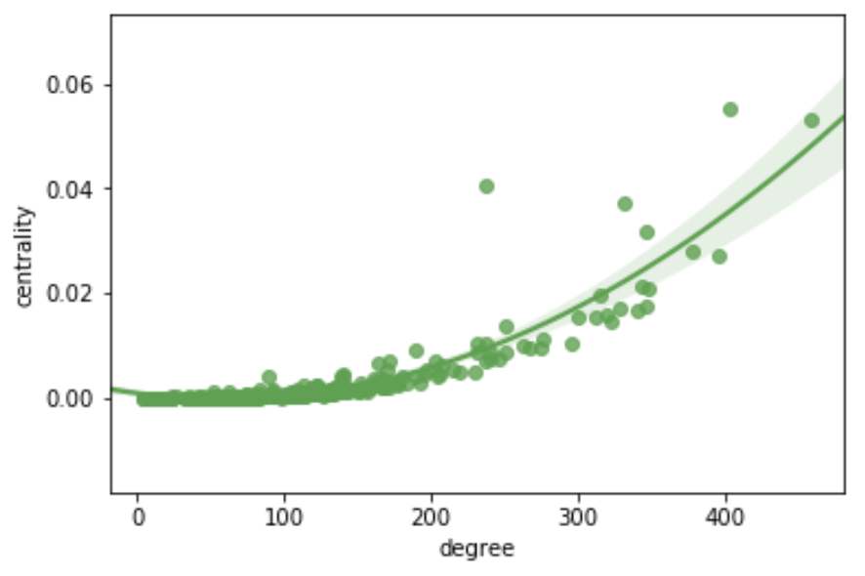
Getting network measures

Slide 42
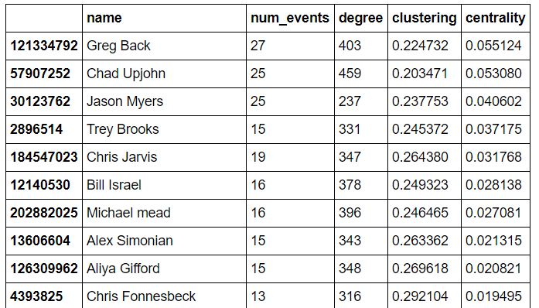
The most “central” Pythonistas

Slide 43
Event Attendance for Upjohn and Myers
Chad Upjohn
degree = 459
Jason myers
Degree = 237
An October Two-fer: Refactoring, Extra Code Included / PDFs Against Humanity
Creating Better Beer Through Data Science
You and I and the PyNash API
PyNash x Penny U: An Evening of Learning
Interactive Python Environments: IPython, Jupyter, and Beaker, Oh My!
PyNash Lunch!
Logging beyond /dev/null -- ELK Stack for Log Visualization and Analysis
PyNash Lunch!
PyNash Lunch!
PyNash Lunch!
You and I and the PyNash API
PyNash Lunch!
PyNash Lunch!
PyNash Lunch!
PyNash Lunch!
PyNash Lunch!

Slide 44
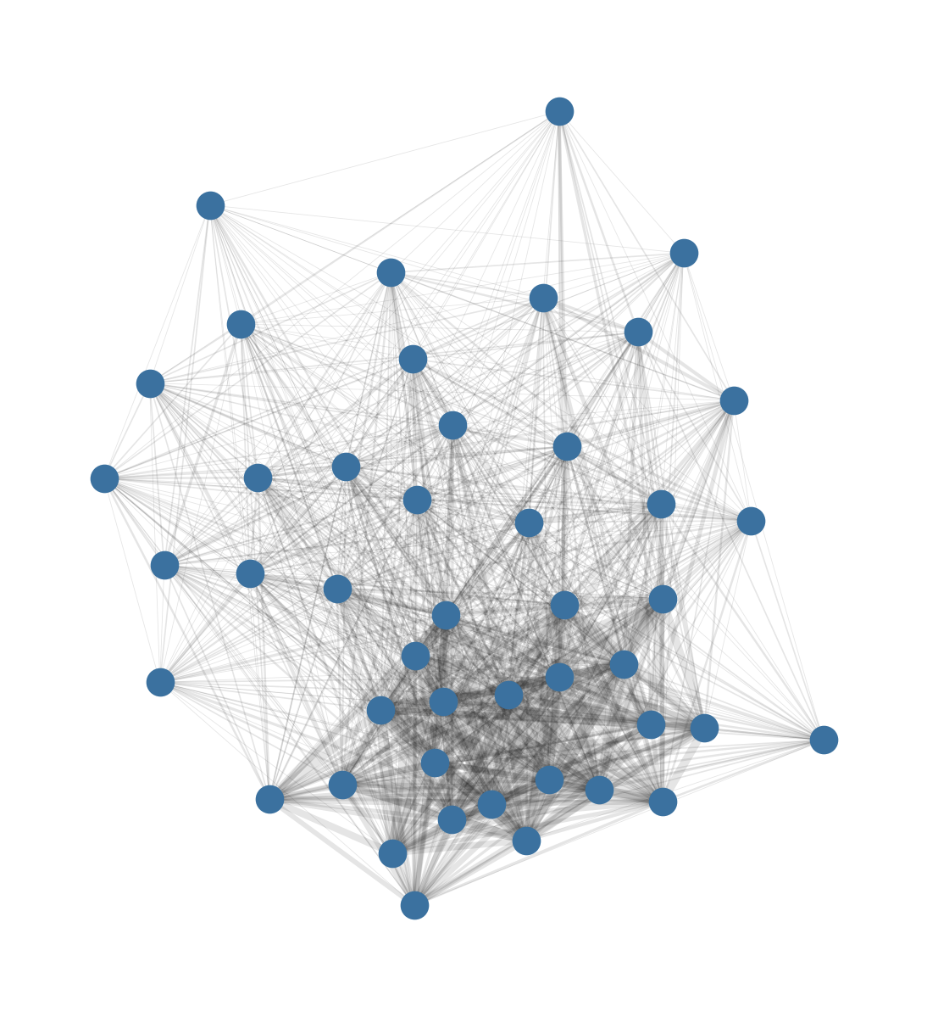
Event Structure

Slide 45
Now, to Nashville!

Slide 46
Making a splash
We now know who to get in touch within PyNash – but what about outside of PyNash?
There are likely going to be clusters of groups
- Tech groups
- Outdoors groups
- Professional groups

Slide 47
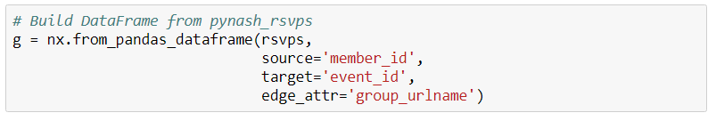
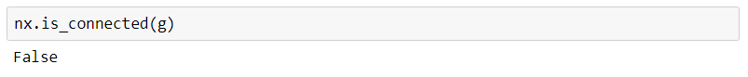
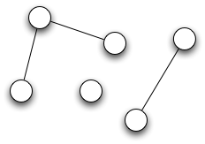

Slide 48
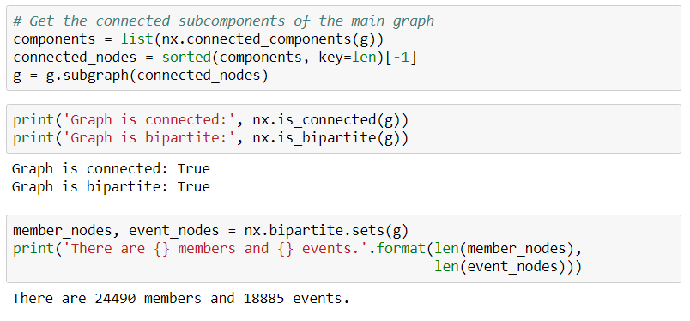

Slide 49
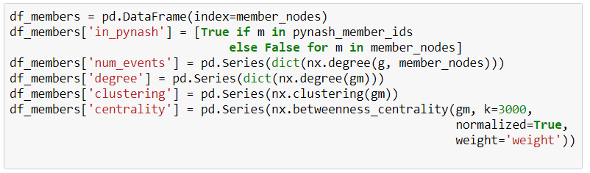

Slide 50
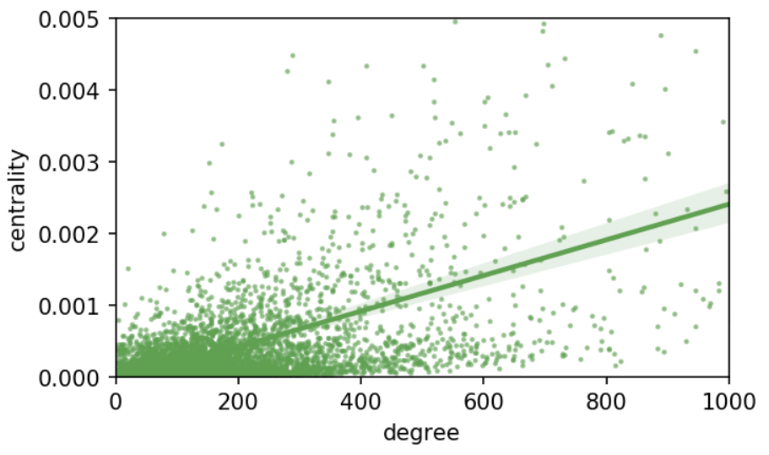
In larger networks, there is a weaker relationship between degree and centrality

Slide 51
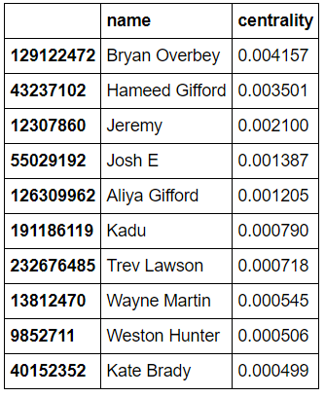
The best networked in the room are…
Highest centrality

Slide 52
The best networked in the room are…
Bryan Overbey (129122472) has attended 27 events total in 22 different groups.
They have attended PyNash 1 time(s).
Top attendance:
- Nashville-Sailing: 5
- steppingoutsocialdance: 2
- Nashville-Free-Guitar-Lesson-Meetup: 1
Highest centrality

Slide 53
The best networked in the room are…
Hameed Gifford (43237102) has attended 29 events total in 15 different groups.
They have attended PyNash 6 time(s).
Top attendance:
- PyNash: 6
- Nashville-soccer: 5
- nashjs: 3

Slide 54
Josh E (55029192) has attended 55 events total in 10 different groups.
They have attended PyNash 13 time(s).
Top attendance:
- PyNash: 13
- NashvilleMobileDotNet: 10
- Nashville-NET-User-Group: 9

Slide 55
Recap of NetworkX
Build graphs
Indexing graphs
nx.Graph()
nx.DiGraph()
nx.from_edge_list()
nx.from_pandas_dataframe()
n = g[node]
e = g[node][node]
w = g[node][node][attribute]
[n for n in g.nodes]
[e[‘weight’] for e in g.edges]

Slide 56
Recap of NetworkX
Build graphs
Draw Graphs
nx.degree(g)
nx.betweenness_centrality(g)
nx.clustering(g)
pos = nx.spring_layout(g)
pos = nx.circular_layout(g)
nx.draw_networkx(g, pos)

